Slide 1
Machine Learning 101

Slide 2
Notes:
The McGill initiative on Computational Medicine was formed in 2017 and aims to deliver inter-disciplinary research programs and empower the use of data in health research and health care delivery
Located at the Genome Center
They have a newsletter were you can subscribe to
more info on the web site

Slide 3
Workshop agenda
Intro to Machine Learning (ML)
ML models
Applications and challenge
Code implementation
Coding session – group activity
Q&A

Slide 6
ML brief background
Intro to Machine Learning (ML)
ML models
Applications and challenge
Code implementation
Coding session – group activity
Q&A

Slide 7
ML major tasks

Slide 8
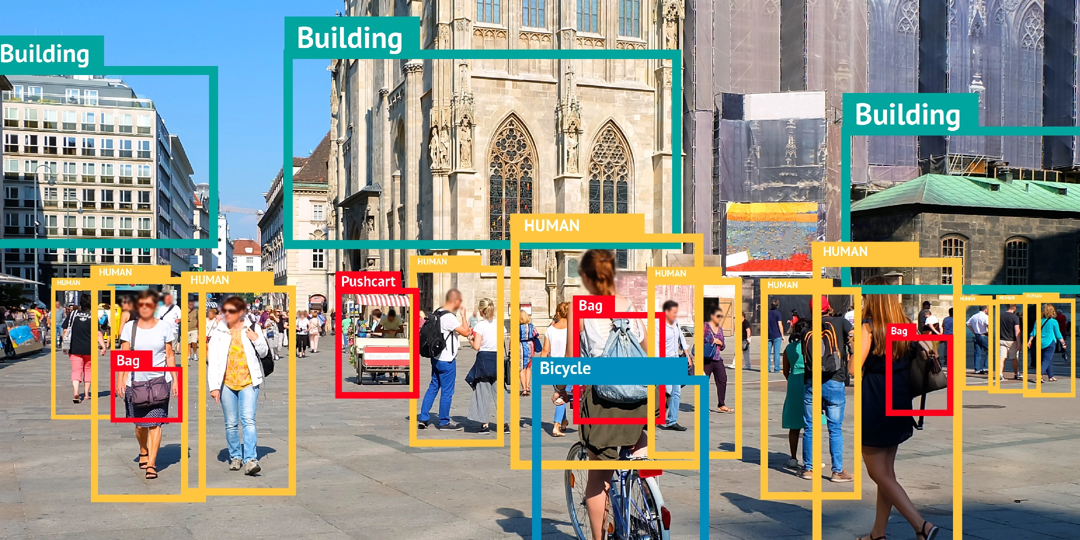
Supervised ML
We have labeled data
Ground truth for the model
Classification
Regression
Image: https://bitmovin.com/object-detection/

Slide 9
Unsupervised ML
We don’t provide labels
Many instances we don’t have them
Clustering
Dimensionality reduction
Anomaly detection
Generative modeling

Slide 10
ML scope

Slide 11
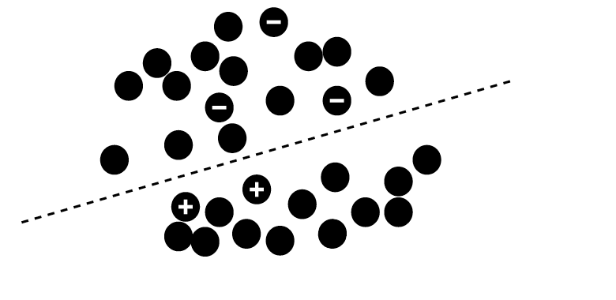
Other ML types
Semi-supervised learning
Only a subset of data is labeled

Slide 12
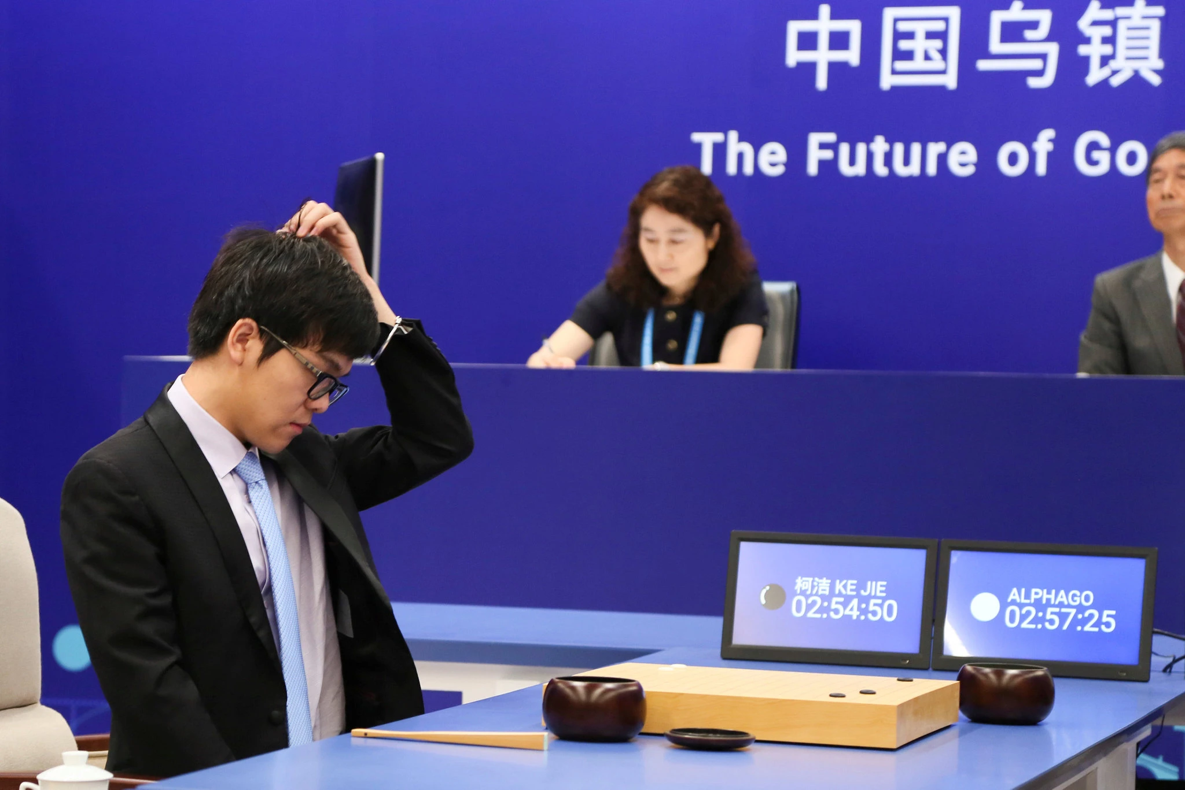
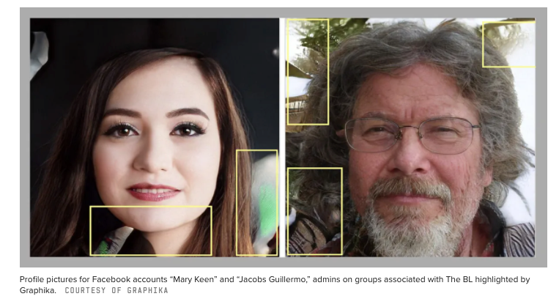
Other ML types
Reinforcement learning
Reward signal
Facebook Removes Accounts With AI-Generated Profile Photos
Ke Jie, the world’s top Go player, reacting during his match on Tuesday against AlphaGo, artificial intelligence software developed by a Google affiliate. Credit...China Stringer Network, via Reuters. May 23, 2017

Slide 13
Title

Slide 14
Title

Slide 15
What is learning?
Learning definition
How to measure learning?
Error between prediction and actual target
Adjust model parameters to decrease error
Repeat until convergence
Loss function

Slide 16

Terminologies
Artificial Intelligence (AI)
Broader science (domain) of incorporating human intelligence to machines
Machine Learning (ML)
Subset of AI, provides computer ability to learn and improve from experience
Many algorithms: Artificial Neural Networks (ANNs), Support Vector Machines (SVM), Decision Trees, …
Deep Learning (DL)
Evolution of ML, focused on advanced techniques of ANN
Inspired by information processing patterns of human brain
Data Science
Umbrella term for the above terms, widely used in industry
Includes data mining

Slide 17
Title

Slide 18
Title

Slide 19
Title

Slide 20
Data format
Features
Also called predictors, inputs, independent variables
Targets
Also called labels, outputs, dependent variables

Slide 21
Building a ML model
Objective definition
Data preparation
Model selection
1
Training
Evaluation
Parameters tuning
2
3
Inference
Final model

Slide 22
Decision Trees (DTs)
Main idea: Divide space into regions using a tree structure
Each region has a label
Classification tasks: class label
Regression tasks: real scalar
Build the DT based on the value of a single variable

Slide 23
DTs motivation
Handling of categorical variables.
Handling of missing values and unknown values.
Detection of non-linear relationships.
Visualization and interpretation in decision trees.

Slide 24
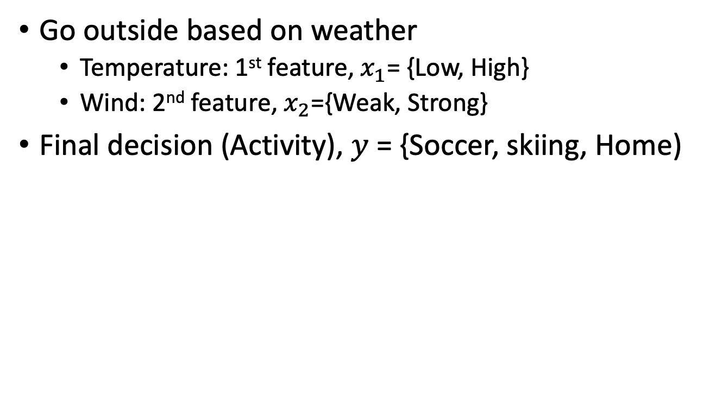
DTs main idea
Go outside based on weather
Temperature: 1st feature, $x_{1}$= {Low, High}
Wind: 2nd feature, $x_{2}$={Weak, Strong}
Final decision (Activity), $y$ = {Soccer, skiing, Home)
Low Temperature?
Strong wind?
Play soccer
Stay home
Strong wind?
Go skiing
Stay home
No
Yes

Slide 25
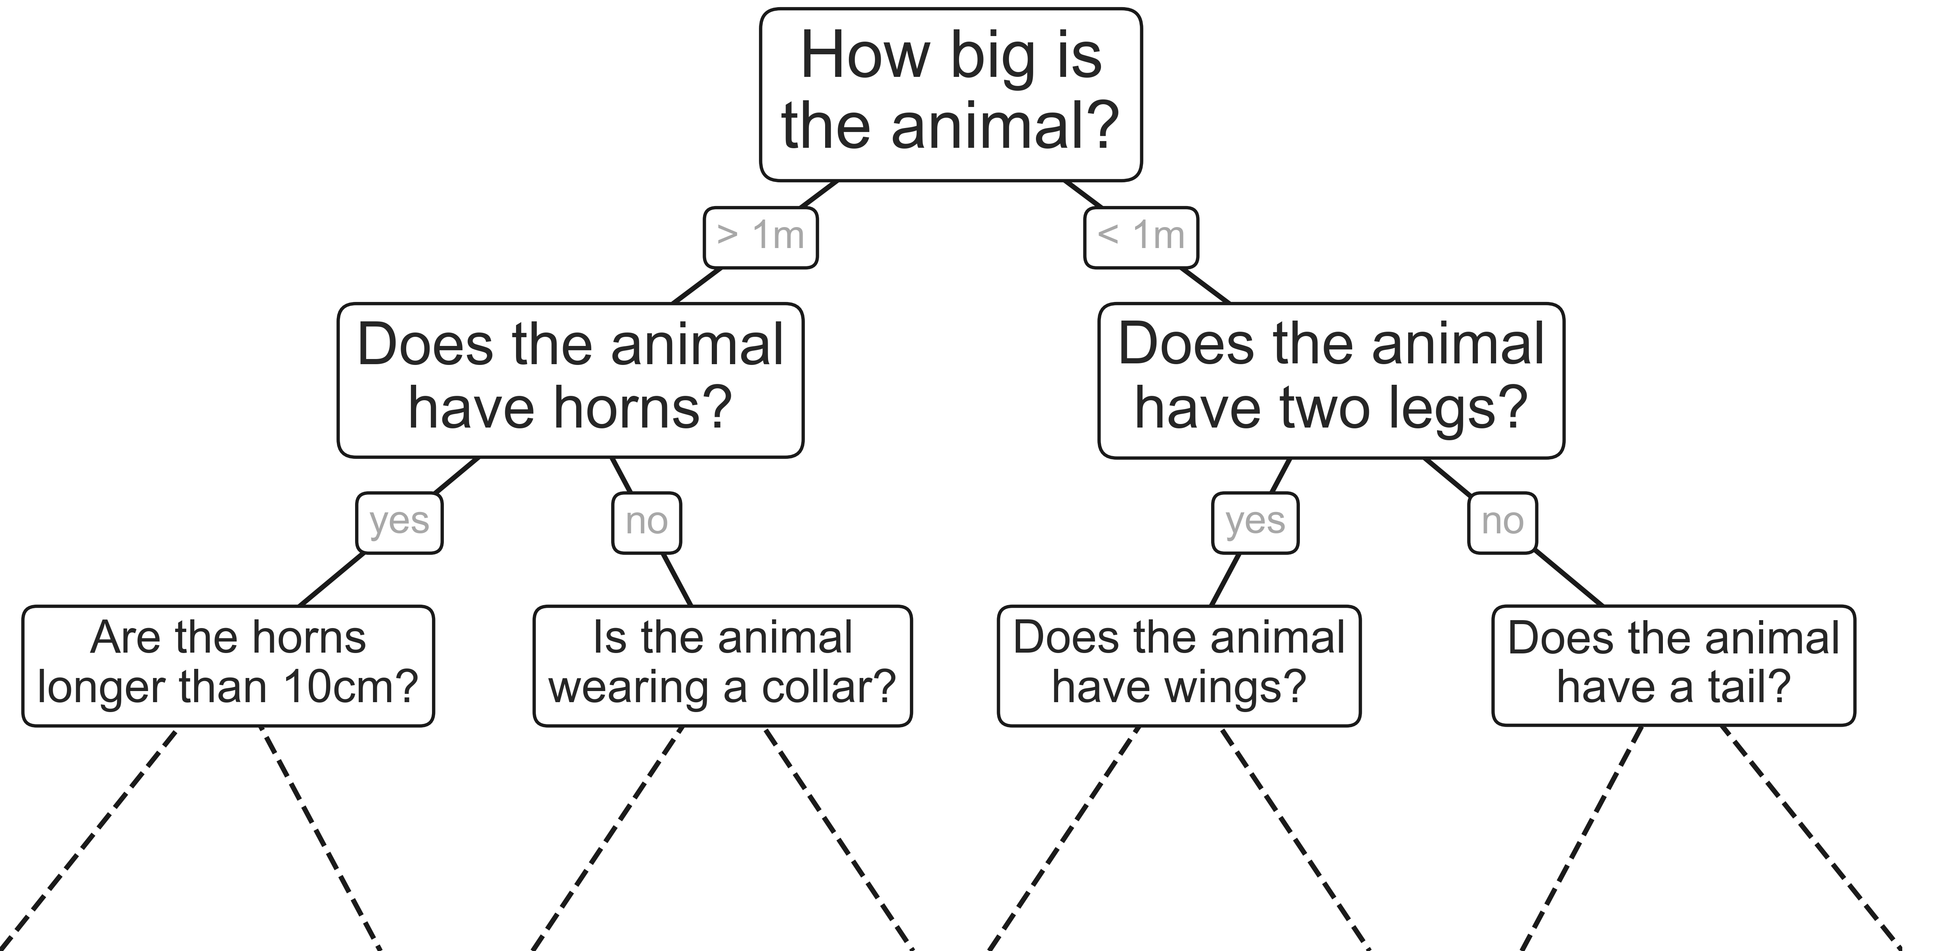
DTs main idea
Intuitive way to classify objects
Series of questions
Classify animals based on criteria

Slide 26
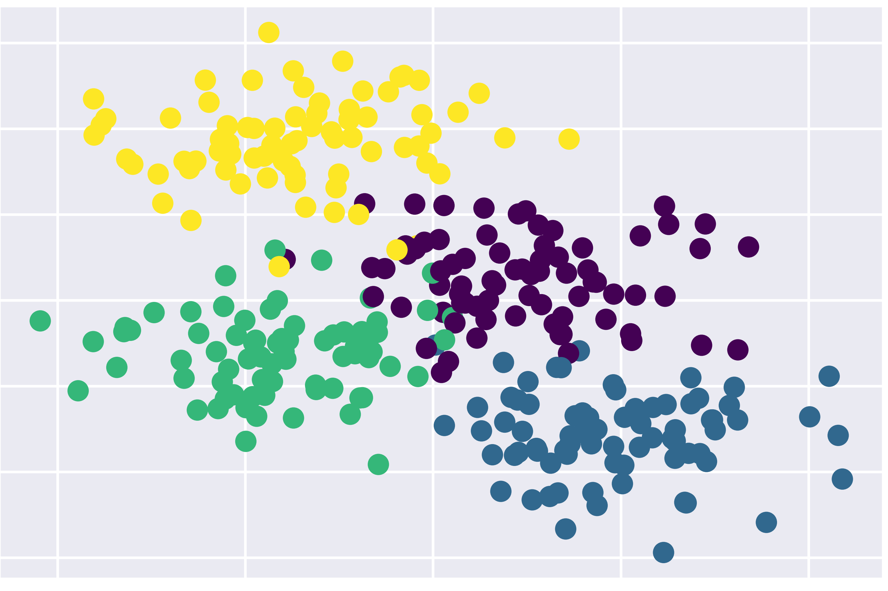
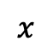
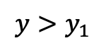
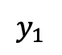
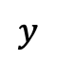
DTs example
$$y>y_{1}$$
$$y$$
$$y_{1}$$
$$x$$

Slide 27
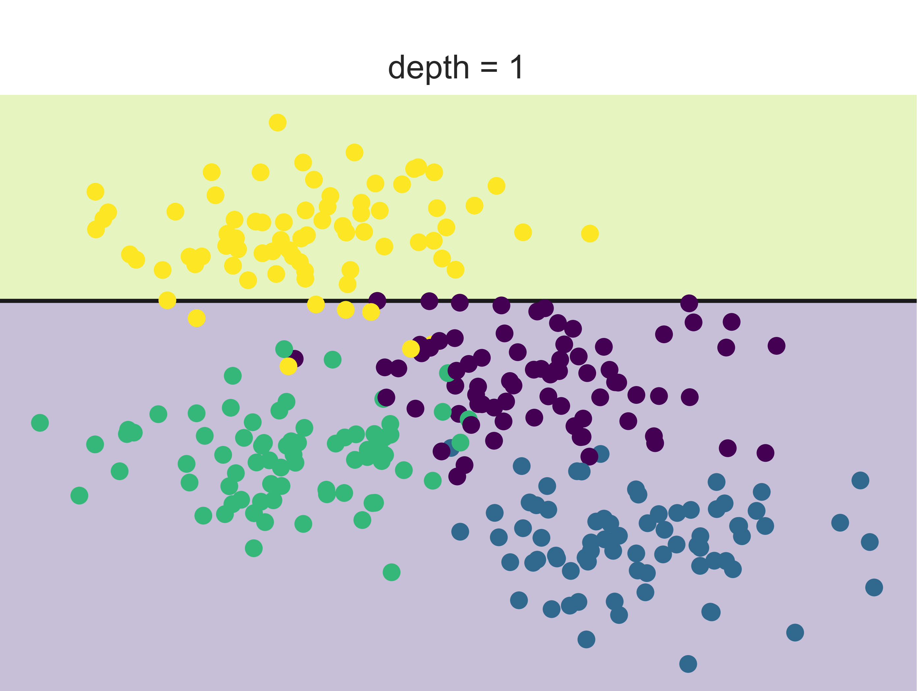
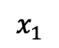
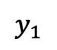
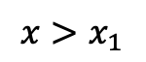
DTs example
$$y>y_{1}$$
$$x>x_{1}$$
$$y$$
yellow
$$y_{1}$$
$$x_{1}$$
$$x$$

Slide 28
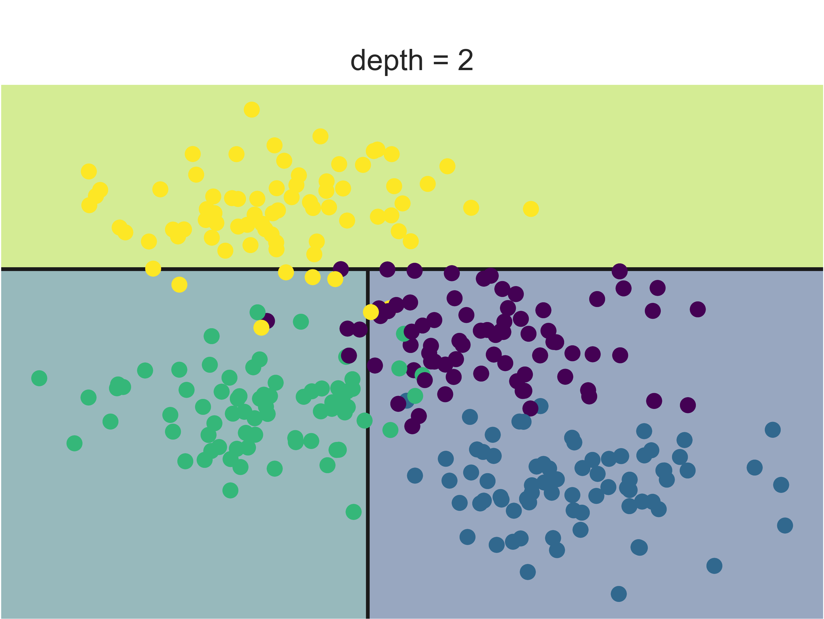
DTs example
$$y>y_{1}$$
$$x>x_{1}$$
$$y$$
yellow
$$y_{1}$$
Green
$$x_{1}$$
$$x$$

Slide 29
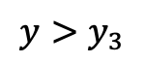
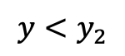
DTs example
$$y>y_{1}$$
$$x>x_{1}$$
$$y$$
yellow
$$y_{1}$$
$$y<y_{2}$$
$$y>y_{3}$$
$$x_{1}$$
$$x$$

Slide 30
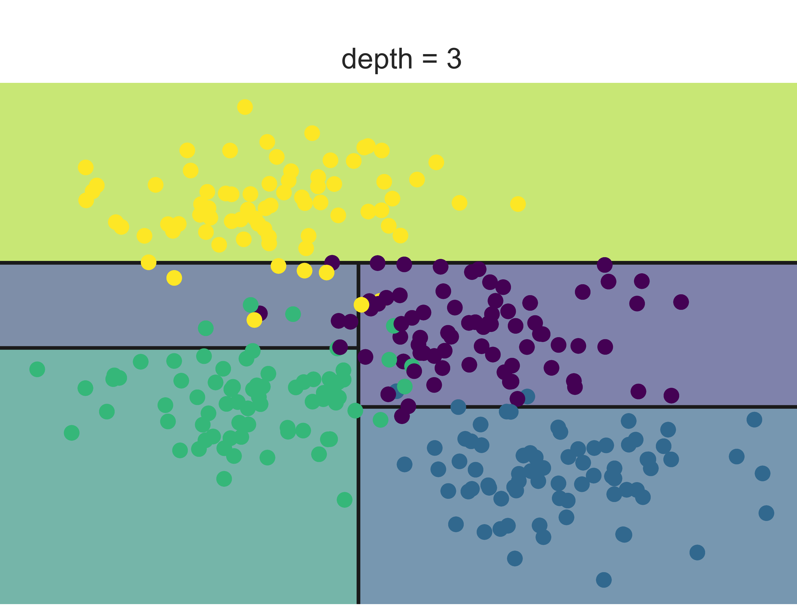
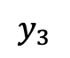
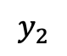
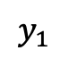
DTs example
$$y>y_{1}$$
$$x>x_{1}$$
$$y$$
yellow
$$y_{1}$$
$$y_{2}$$
$$y_{3}$$
$$y<y_{2}$$
$$y>y_{3}$$
$$x_{1}$$
$$x$$
yellow
Green
blue
purple

Slide 31
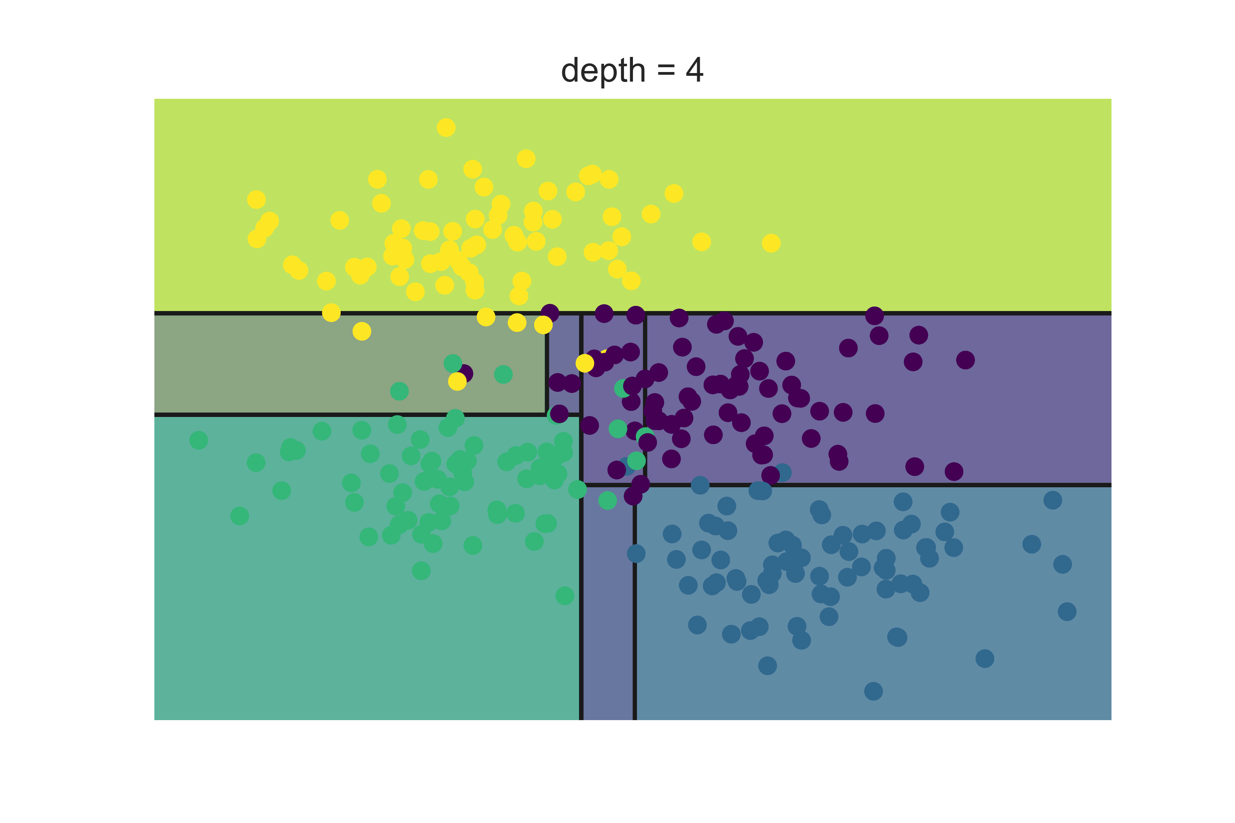
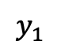
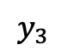
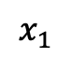
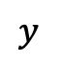
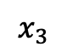
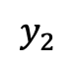
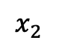
DTs example
This process can go on and on..
$$y$$
$$y_{1}$$
$$y_{2}$$
$$y_{3}$$
$$x_{3}$$
$$x_{2}$$
$$x_{1}$$
$$x$$

Slide 32
DTs example
Visual example: Home classification in San Francisco and New York

Slide 33
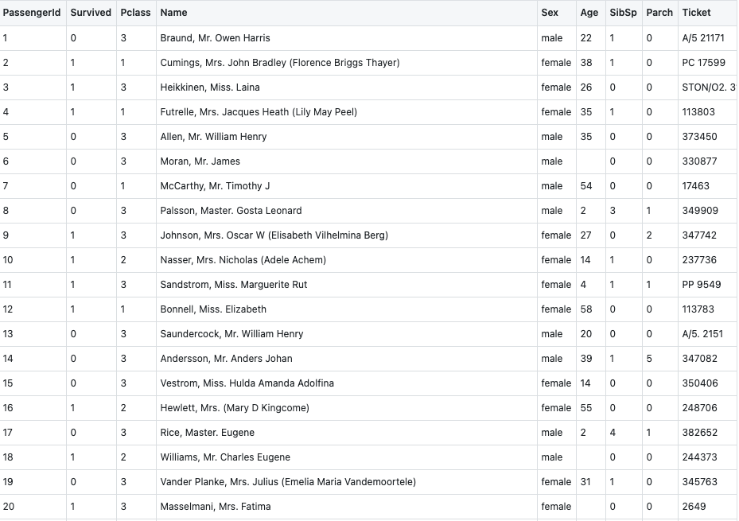
Titanic Dataset

Slide 34
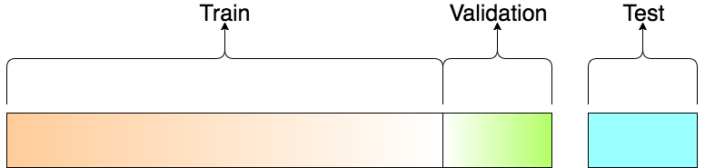
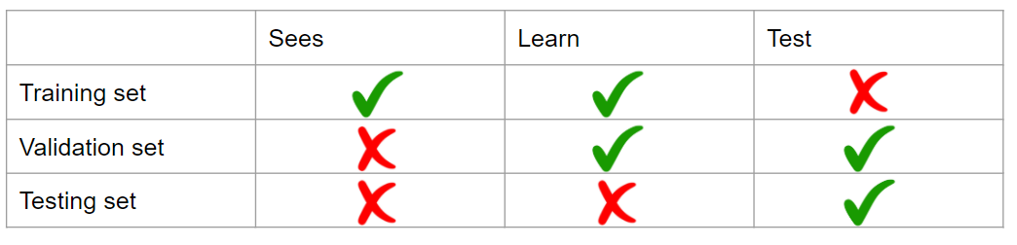
Train and Test sets

Slide 35
Title

Slide 36
Title

Slide 37
Title

Slide 38
Next steps
Resources
Online courses
Explore datasets

Slide 39
References

